Slide 1
CNN Architecture

Slide 2
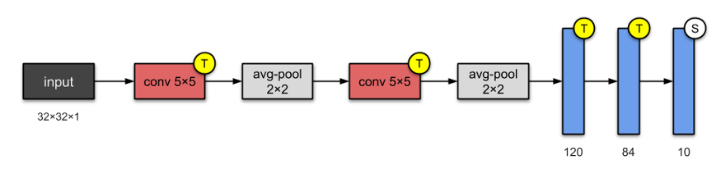
1. LeNet-5 (1998)
LeNet-5 is one of the simplest architectures. It has 2 convolutional and 3 fully-connected layers (hence “5” — it is very common for the names of neural networks to be derived from the number of convolutional and fully connected layers that they have). The average-pooling layer as we know it now was called a sub-sampling layer and it had trainable weights (which isn’t the current practice of designing CNNs nowadays). This architecture has about 60,000 parameters.
Authors: Yann LeCun, Léon Bottou, Yoshua Bengio, and Patrick Haffner
Published in: Proceedings of the IEEE (1998)

Slide 3
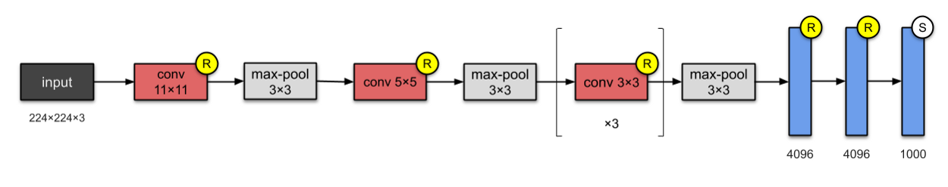
2. AlexNet (2012)
With 60M parameters, AlexNet has 8 layers — 5 convolutional and 3 fully-connected. AlexNet just stacked a few more layers onto LeNet-5. At the point of publication, the authors pointed out that their architecture was “one of the largest convolutional neural networks to date on the subsets of ImageNet.”
They were the first to implement Rectified Linear Units (ReLUs) as activation functions
Authors: Alex Krizhevsky, Ilya Sutskever, Geoffrey Hinton. University of Toronto, Canada.

Slide 4
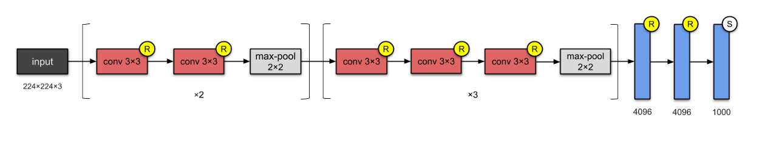
3. VGG-16 (2014)
By now you would’ve already noticed that CNNs were starting to get deeper and deeper. This is because the most straightforward way of improving performance of deep neural networks is by increasing their size (Szegedy et. al). The folks at Visual Geometry Group (VGG) invented the VGG-16 which has 13 convolutional and 3 fully-connected layers, carrying with them the ReLU tradition from AlexNet. This network stacks more layers onto AlexNet, and use smaller size filters (2×2 and 3×3). It consists of 138M parameters and takes up about 500MB of storage space. They also designed a deeper variant, VGG-19.
Authors: Karen Simonyan, Andrew Zisserman. University of Oxford, UK.

Slide 5
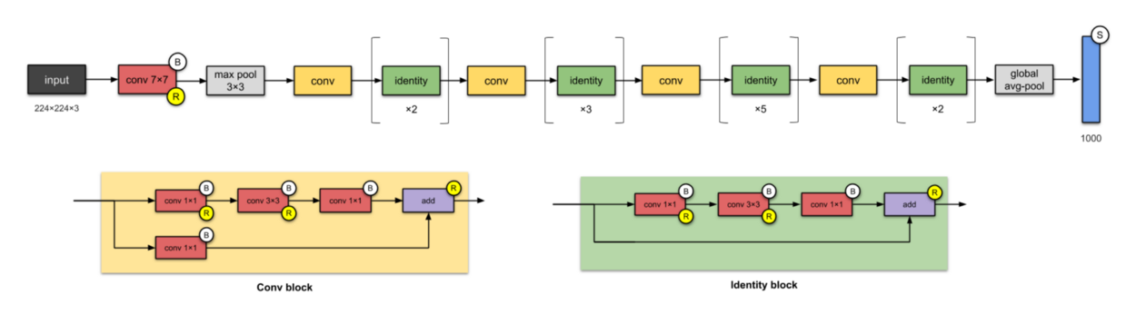
4. ResNet-50 (2015)
From the past few CNNs, we have seen nothing but an increasing number of layers in the design, and achieving better performance. But “with the network depth increasing, accuracy gets saturated (which might be unsurprising) and then degrades rapidly.” The folks from Microsoft Research addressed this problem with ResNet — using skip connections (a.k.a. shortcut connections, residuals), while building deeper models.
ResNet is one of the early adopters of batch normalisation (the batch norm paper authored by Ioffe and Szegedy was submitted to ICML in 2015). Shown above is ResNet-50, with 26M parameters.
The basic building block for ResNets are the conv and identity blocks.
Designing even deeper CNNs (up to 152 layers) without compromising model’s generalisation power
Authors: Kaiming He, Xiangyu Zhang, Shaoqing Ren, Jian Sun. Microsoft

Slide 6
5. Inception-v1 (2014)
Having parallel towers of convolutions with different filters, followed by concatenation, captures different features at 1×1, 3×3 and 5×5, thereby ‘clustering’ them. This idea is motivated by Arora et al. in the paper Provable bounds for learning some deep representations, suggesting a layer-by layer construction in which one should analyse the correlation statistics of the last layer and cluster them into groups of units with high correlation.
1×1 convolutions are used for dimensionality reduction to remove computational bottlenecks.
Due to the activation function from 1×1 convolution, its addition also adds nonlinearity
Building networks using modules/blocks. Instead of stacking convolutional layers, we stack modules or blocks, within which are convolutional layers. Authors: Christian Szegedy,

Slide 7
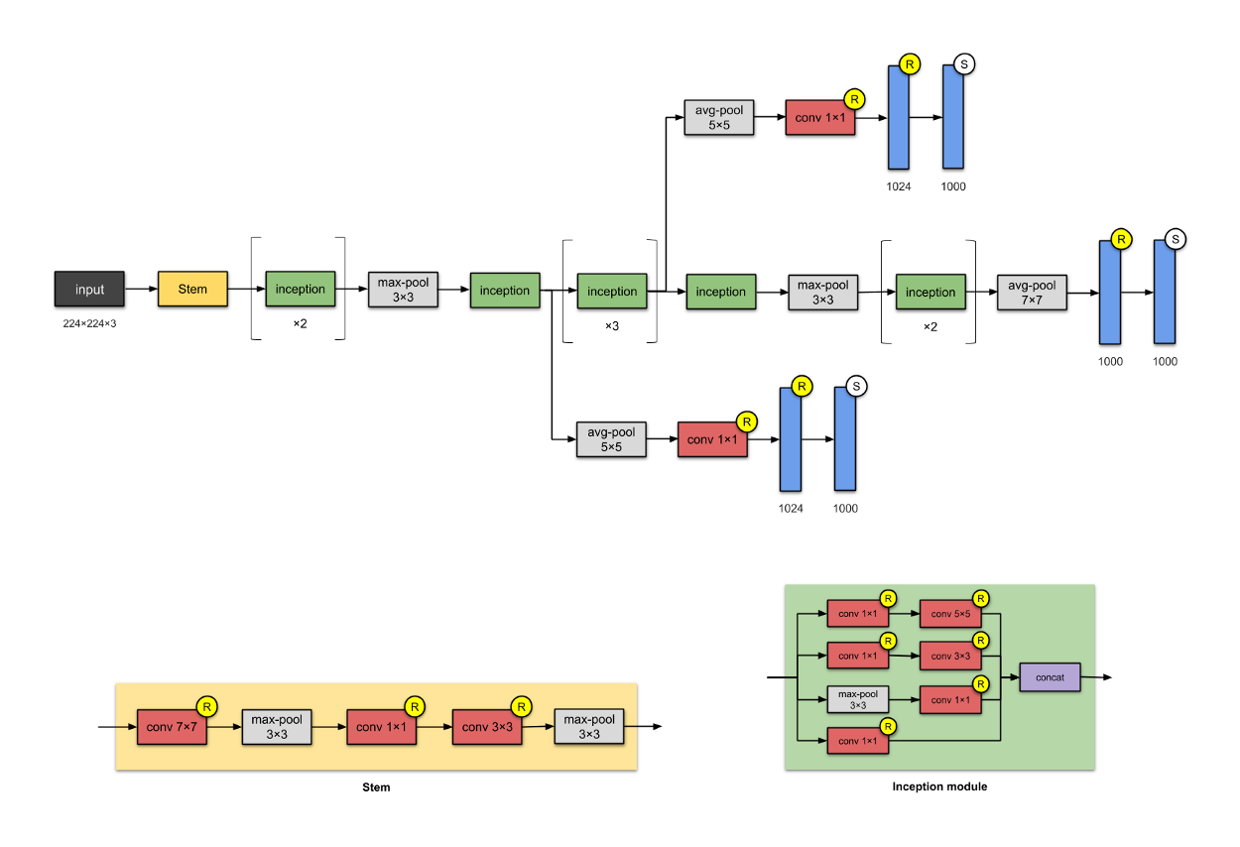
Inception-v1 (2014)

